Slide 1

Shot Cafe: movie shot analysis
Marco Raffaele, 1799912
Gabriele De Lucia, 1811284
Big Data Computing 22/23

Slide 2
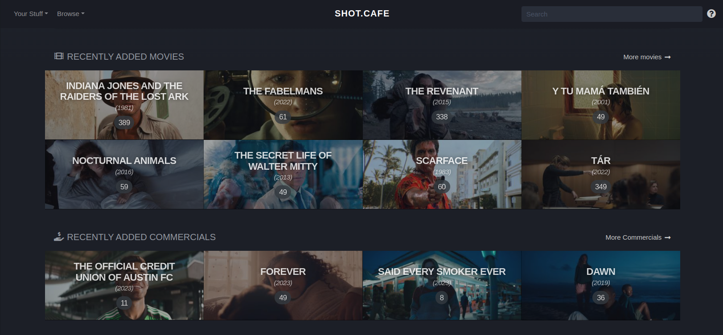
Dataset Introduction

Slide 3
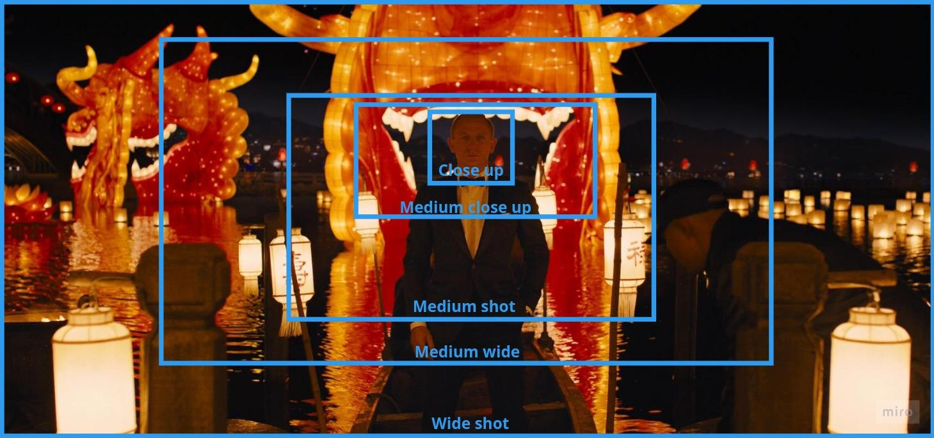
Shot type classification

Slide 4
Shot type classification: Approaches
First approach:
VGG16 Transfer learning
Second approach:
VGG16 (Featurization) + Support Vector Machine (classification)

Slide 5
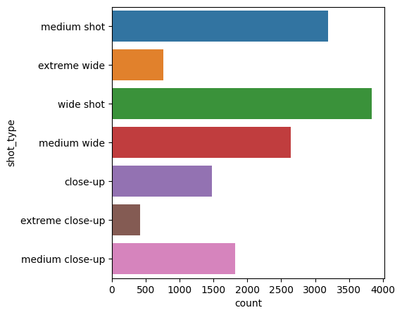
Shot type classification: Dataset creation
Shot_type | Count
medium shot | 1475
wide shot | 1475
medium wide | 1475
close-up | 1475
medium close-up | 1475

Slide 6
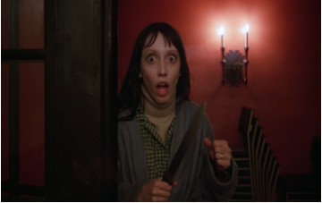
Shot type classification: VGG16 Transfer learning
Close up
Medium close up
Medium shot
Medium wide
Wide shot
Pre-trained VGG16

Slide 7
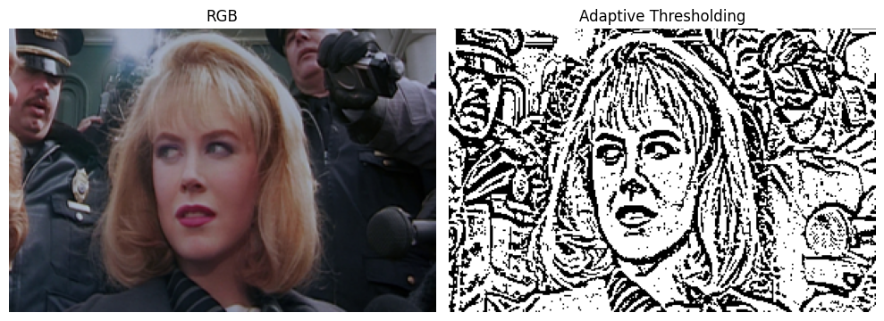
Shot type classification: Image preprocessing

Slide 8
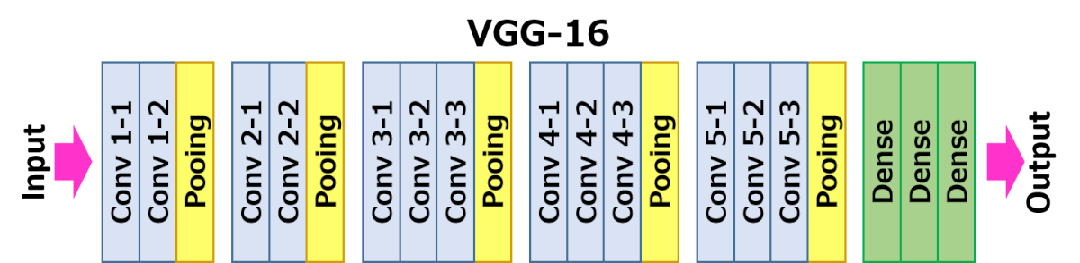
Shot type classification: VGG16 model definition
VGG16 Architecture

Slide 9
Shot type classification: Training
Tuned parameters
RGB Training configurations:
(Learing_rate = 1e-5, Freezed_layers = 16, Batch_size = 32, Epochs = 50)
Adaptive Thresholding Training configurations:
Learing_rate = 1e-5, Freezed_layers = 16, Batch_size = 32, Epochs = 50)
Learing_rate = 1e-3, Freezed_layers = 17, Batch_size = 32, Epochs = 50)

Slide 10
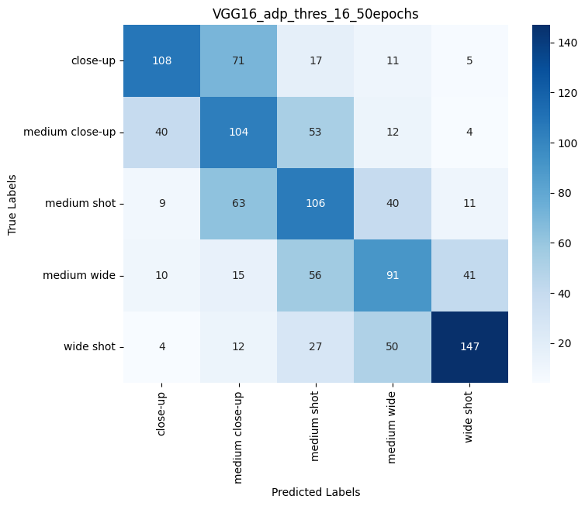
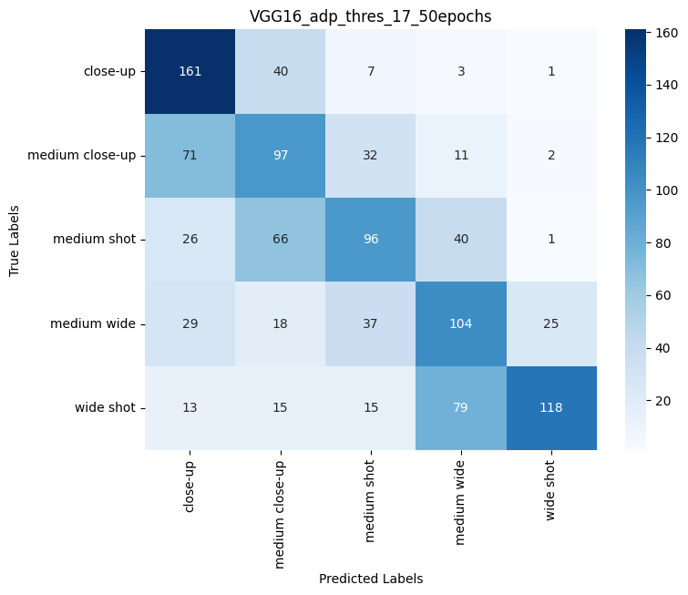
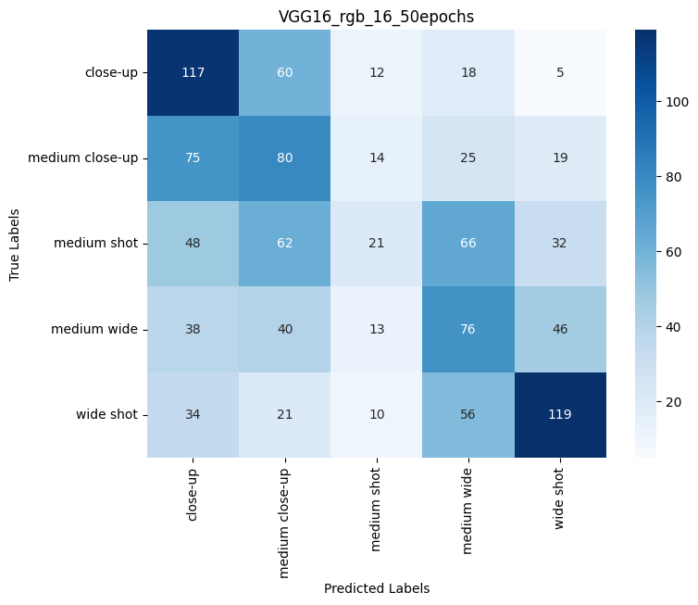
Shot type classification: Results
Accuracy: 0.5022
F1 Score: 0.5078
Accuracy: 0.5203
F1 Score: 0.5202
Accuracy: 0.3730
F1 Score: 0.3556

Slide 11
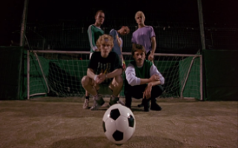
Shot type classification: VGG16 + SVM
Close up
Medium close up
Medium shot
Medium wide
Wide shot
VGG16
SVM
Feature Vector

Slide 12
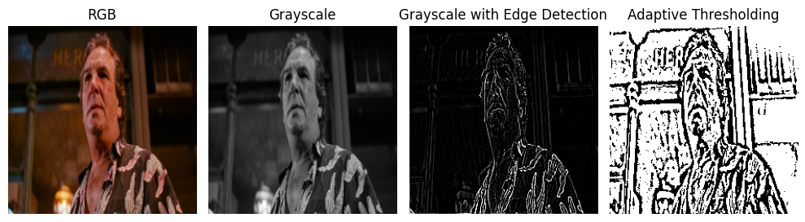
Shot type classification: Image preprocessing

Slide 13
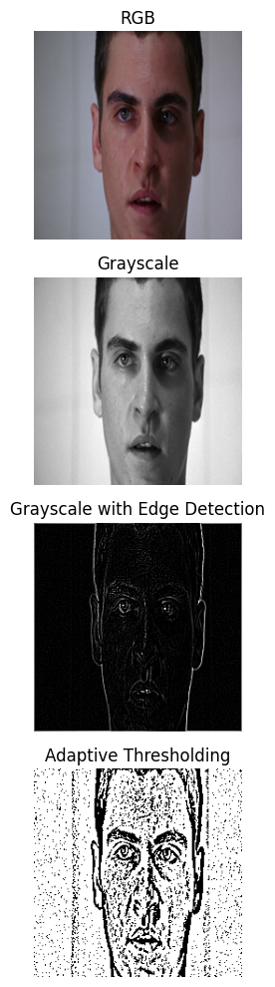
Shot type classification: VGG16 Feature Extraction
VGG16
[0.0, 0.7328359, . . . ]
Feature Vector
Pre-processed Image

Slide 14
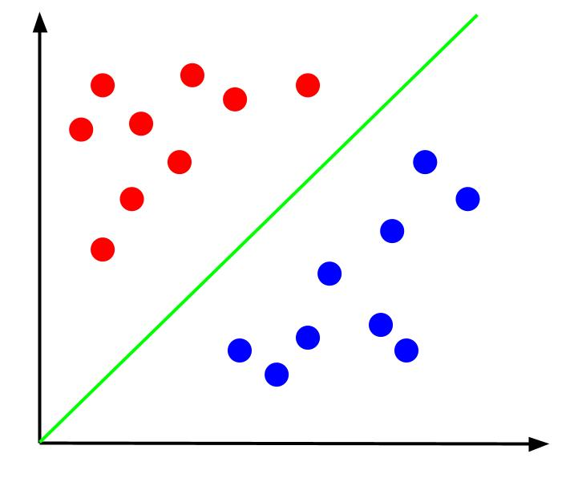
Shot type classification: Support Vector Machine
Close up
Medium close up
Medium shot
Medium wide
Wide shot
[0.0, 07328359, . . .]
Feature Vector
SVM

Slide 15
Shot type classification: Training
Tuned parameters
RGB, Grayscale, Adaptive Thresholding, Edge Detection:
regParam: [0.01, 0.1, 1.0]
maxIter: [10, 20, 30]

Slide 16
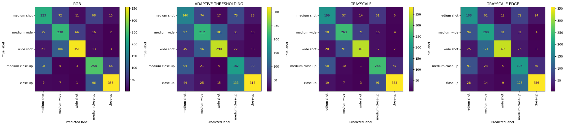
Shot type classification: Results 1
Accuracy = 0.6544
Precision = 0.5560
Recall = 0.5994
F1 Score = 0.5769
Accuracy = 0.5268
Precision = 0.4953
Recall = 0.4618
F1 Score = 0.4780

Slide 17
Shot type classification: Results 2
Accuracy = 0.6672
Precision = 0.6144
Recall = 0.5923
F1 Score = 0.6032
Accuracy = 0.5846
Precision = 0.4883
Recall = 0.4976
F1 Score = 0.4929

Slide 18
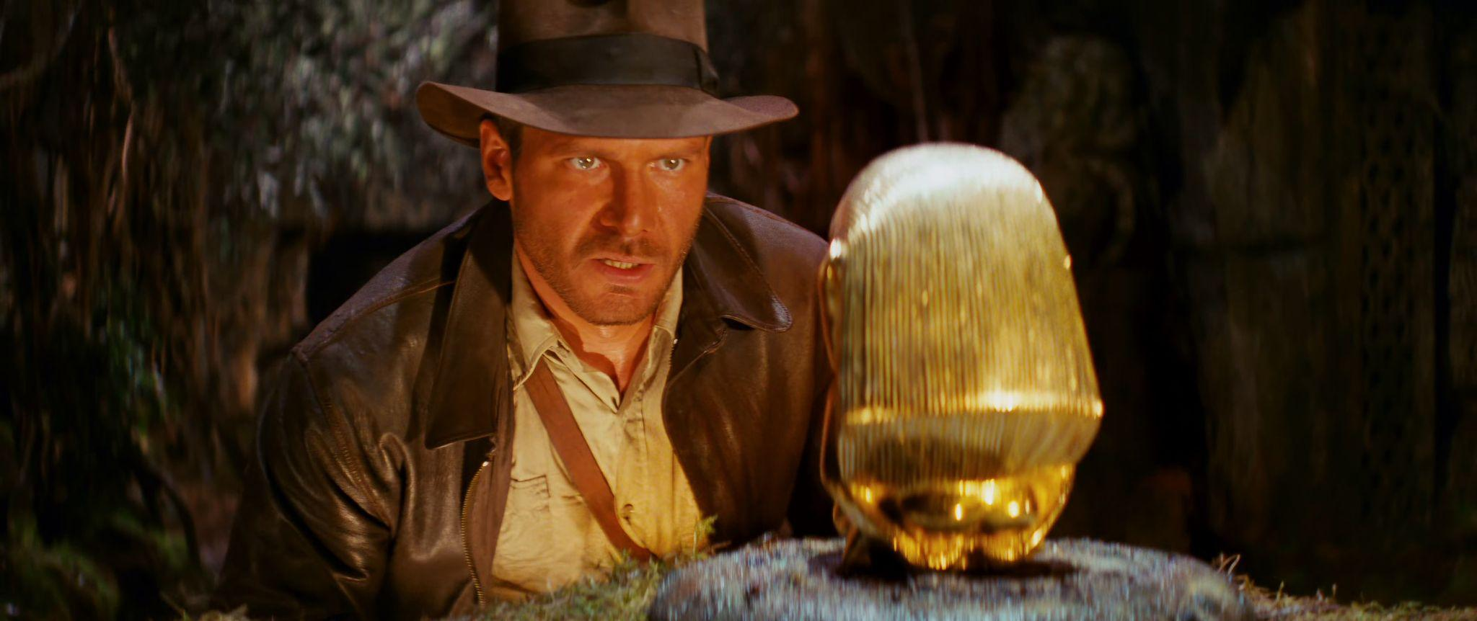
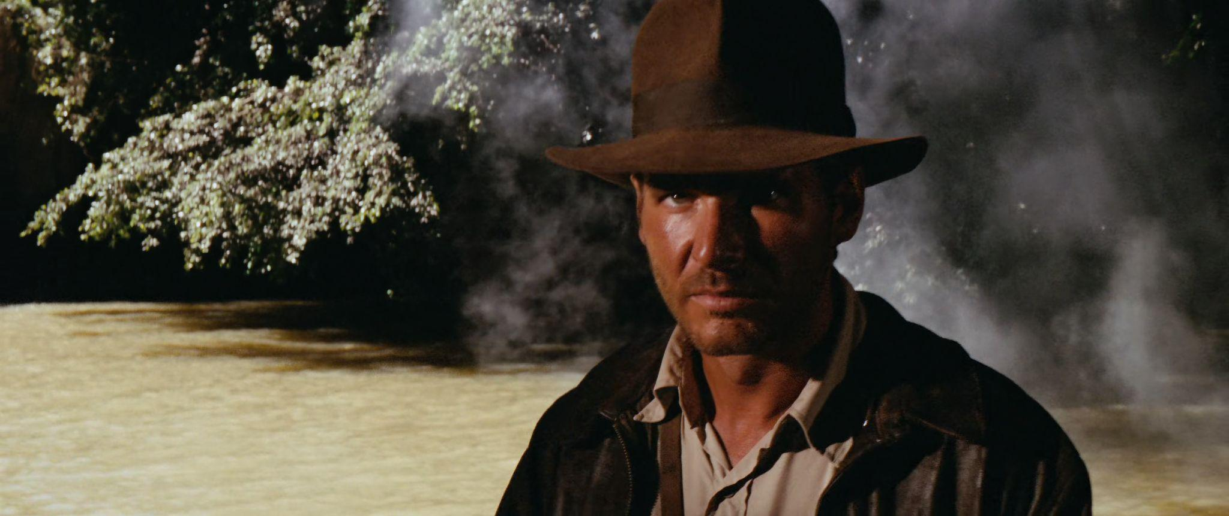
Shot ambient classification: interior, exterior
Interior
Exterior

Slide 19
Shot ambient classification: Approaches
First approach:
Convolutional Neural Network
Second approach:
VGG16 (Featurization) + Logistic Regression (classification)

Slide 20
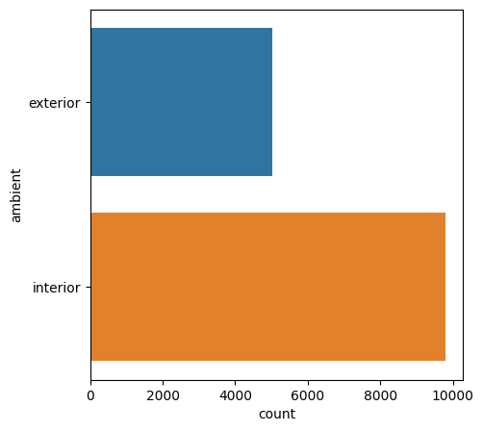
Shot ambient classification: Dataset creation
Shot_type | Count
Exterior | 3500
Interior | 3500

Slide 21


Shot ambient classification: Conv. Neural Network
Exterior
Interior
CNN

Slide 22
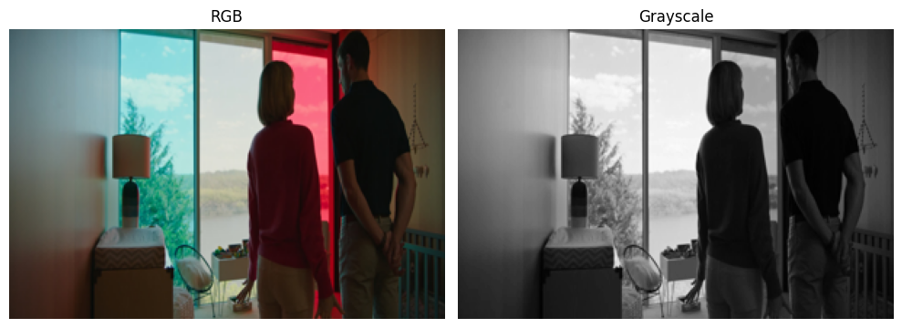
Shot ambient classification: Image Preprocessing

Slide 23
Shot ambient classification: CNN Architecture
Model: "sequential"
_________________________________________________________________
Layer (type) Output Shape Param #
=================================================================
conv2d (Conv2D) (None, 222, 222, 32) 896
max_pooling2d (MaxPooling2D) (None, 111, 111, 32) 0
conv2d_1 (Conv2D) (None, 109, 109, 64) 18496
max_pooling2d_1 (MaxPooling2D) (None, 54, 54, 64) 0
conv2d_2 (Conv2D) (None, 52, 52, 128) 73856
max_pooling2d_2 (MaxPooling2D) (None, 26, 26, 128) 0
conv2d_3 (Conv2D) (None, 24, 24, 256) 295168
max_pooling2d_3 (MaxPooling2D) (None, 12, 12, 256) 0
flatten (Flatten) (None, 36864) 0
dense (Dense) (None, 64) 2359360
dense_1 (Dense) (None, 1) 65
=================================================================
Total params: 2,747,841
Trainable params: 2,747,841
Non-trainable params: 0

Slide 24
Shot ambient classification: Training
Tuned parameters
RGB Training configurations:
(Learning_rate = 0.001, Batch_size = 32, Epochs = 100)
(Learinng_rate = 0.0001, Batch_size = 32, Epochs = 100)
Grayscale Training configurations:
(Learning_rate = 0.001, Batch_size = 32, Epochs = 100)
(Learinng_rate = 0.0001, Batch_size = 32, Epochs = 100)

Slide 25
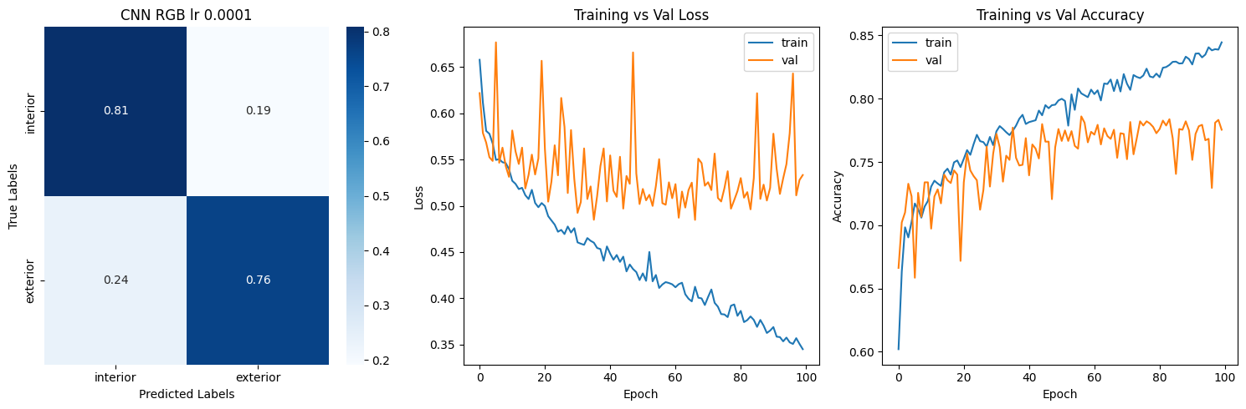
Shot ambient classification: Results 1
Best model with RGB preprocessing
Accuracy = 0.7860
F1 Score = 0.7858

Slide 26
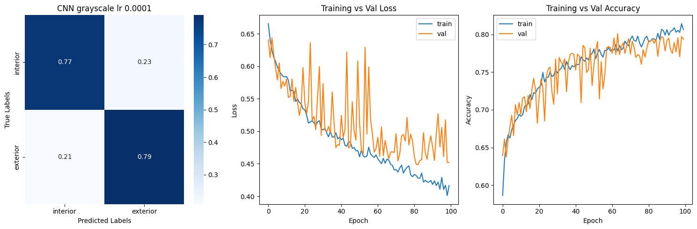
Shot ambient classification: Results 2
Best model with Grayscale preprocessing
Accuracy = 0.7815
F1 Score = 0.7817

Slide 27
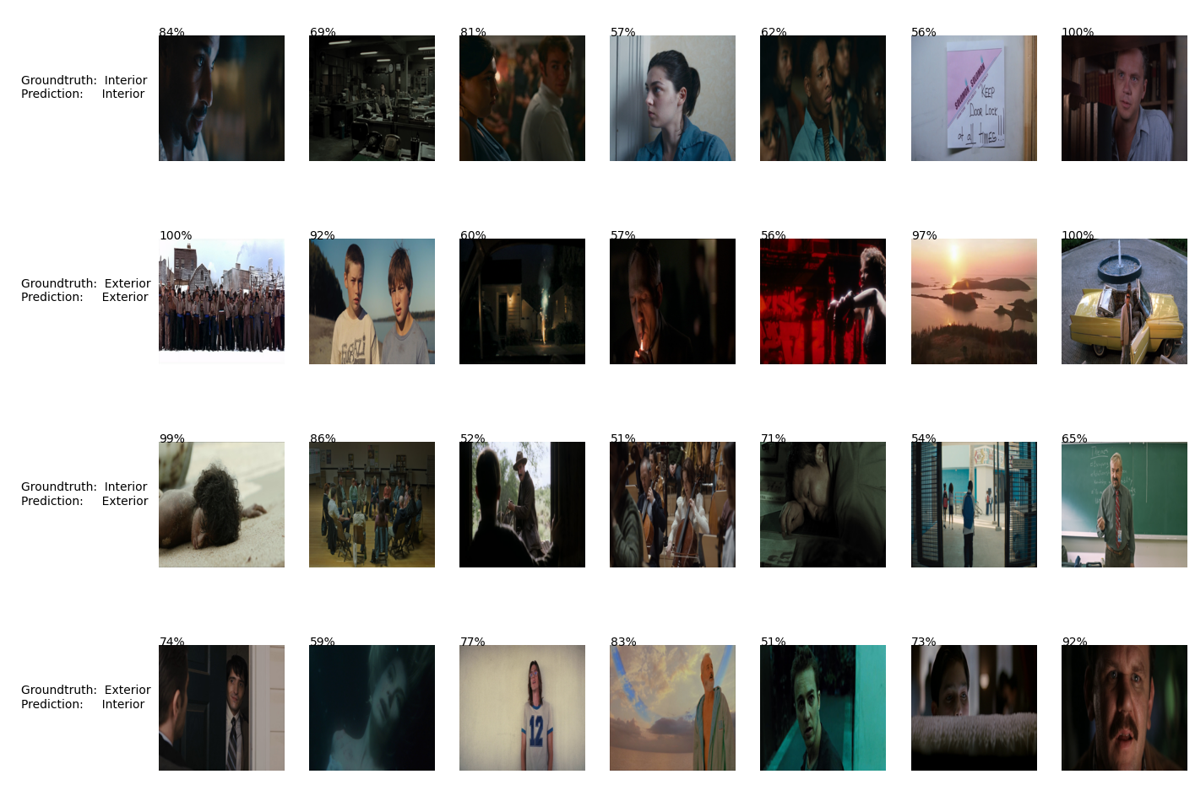
Shot ambient classification: Visualize prediction

Slide 28
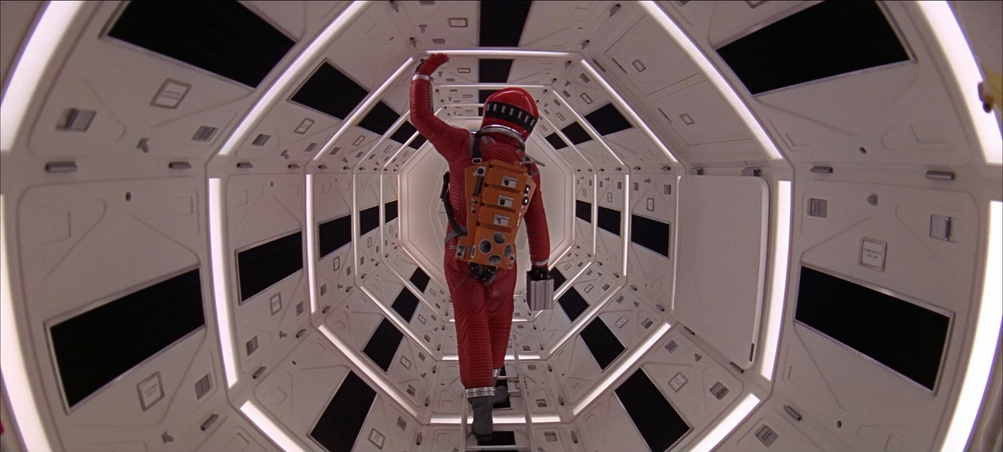
Shot ambient classification: VGG16 + Logistic Regression
Logistic Regression
Exterior
Interior
VGG16
Feature Vector

Slide 29
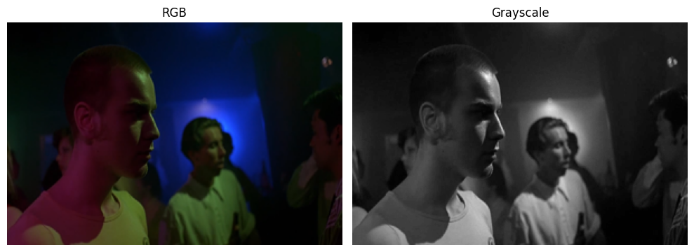
Shot ambient classification: Image preprocessing

Slide 30
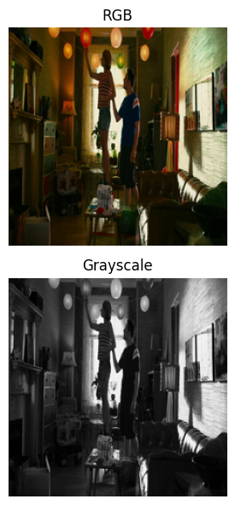
Shot ambient classification: VGG16 Feature Extraction
VGG16
[0.0, 0.4537283, . . . ]
Feature Vector
Pre-processed Image - (224, 224)

Slide 31
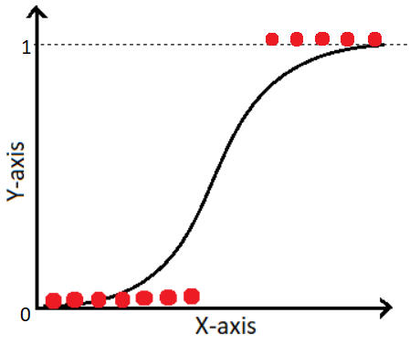
Shot ambient classification: Logistic Regression
Exterior
Interior
[0.0, 0.4537283, . . . ]
Feature Vector
Logistic Regression

Slide 32
Shot ambient classification: Training
Tuned parameters
RGB, Grayscale, Adaptive Thresholding, Edge Detection:
regParam: [0.01, 0.1, 1.0]
elasticNetParam: [0.0, 0.5, 1.0]

Slide 33
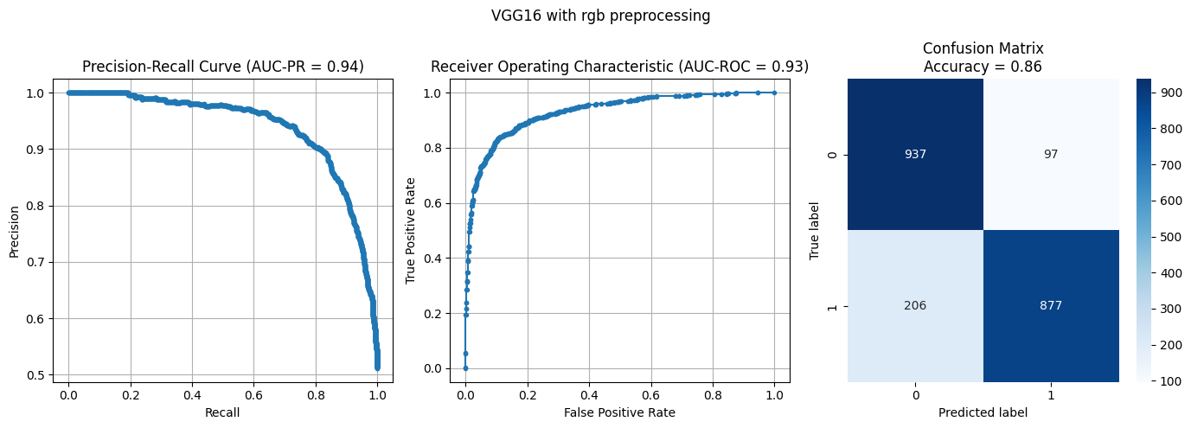
Shot ambient classification: Results 1
RGB preprocessing
Accuracy = 0.86
AUC-PR = 0.94
AUC-ROC = 0.93

Slide 34

Shot ambient classification: Results 2
Grayscale preprocessing
Accuracy = 0.84
AUC-PR = 0.93
AUC-ROC = 0.92

Slide 35
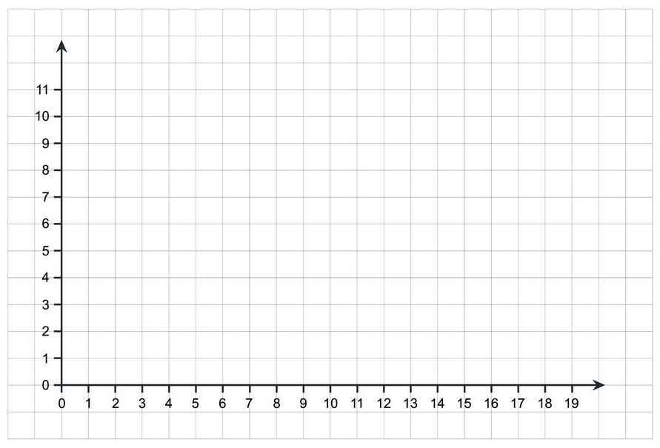
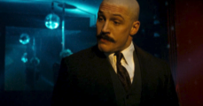
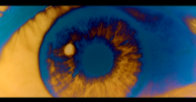
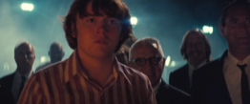
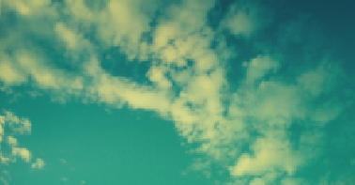
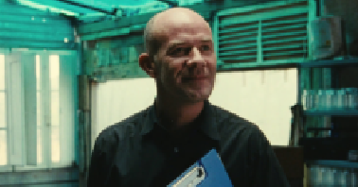
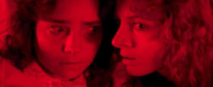
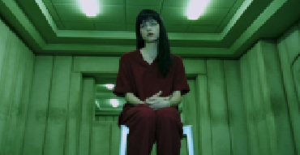
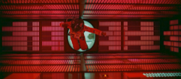
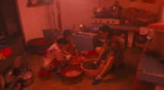
Color palette clustering

Slide 36
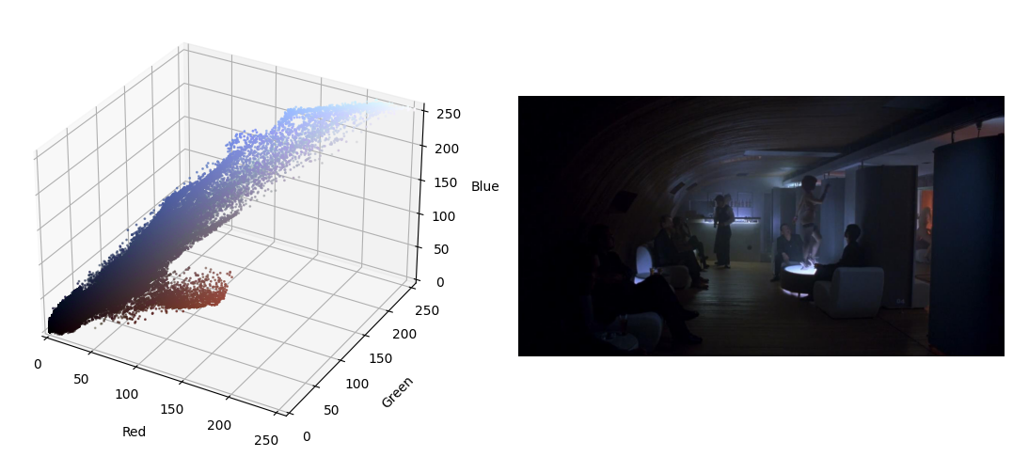
Color palette clustering: 3D Plot
Original image
RGB 3D plot

Slide 37

Color palette clustering: extraction
RGB 3D plot
K = 6
Color palette with 6 colors
Kmeans

Slide 38
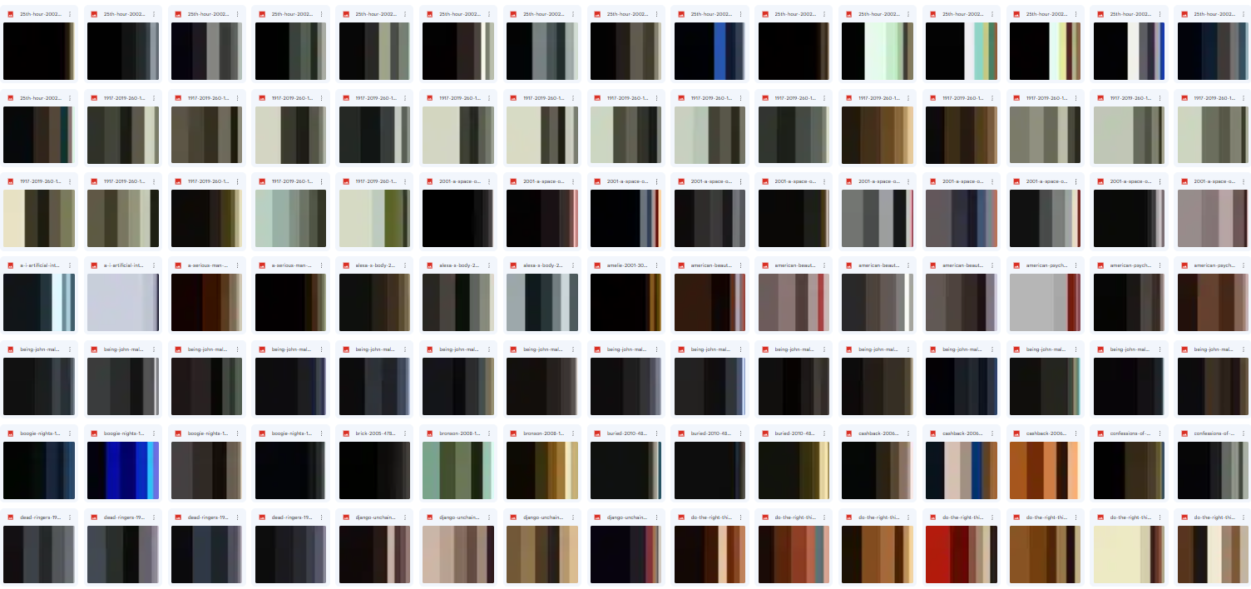
Color palette clustering: palettes

Slide 39
Color palette clustering: approaches
Plain:
1st row of palette images -> K-means
ResNet:
Palette images -> ResNet50 -> Extracted Features -> K-means

Slide 40



Color palette clustering: plain
The shape of the arrays is 3 channels x 50 pixels
[[53, 111, 148], [53, 111, 148], . . . , [107, 50, 61]]
[[104, 85, 41], [104, 85, 41], . . . , [133, 131, 100]]
[[16, 7, 0], [16, 7, 0], . . . , [78, 22, 17]]

Slide 41
Color palette clustering: ResNet50 approach
Flattened features Vector, 150 x 1
[53, 111, 148, 53, 111, 148, . . . , 107, 50, 61]
K-Means
[104, 85, 41, 104, 85, 41, . . . , 133, 131, 100]
[16, 7, 0, 16, 7, 0, . . . , 78, 22, 17]

Slide 42
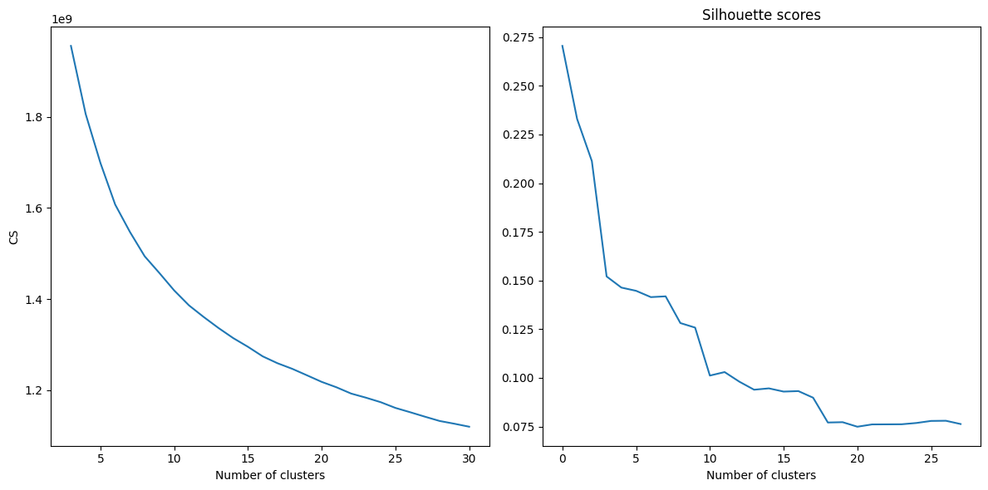
Color palette clustering: plain - Search of optimal K
*The values on the x axis of the silhouette score should actually be x+3, so 10 it’s actually 13 and the graph goes from 3 to 30 just like the elbow method one

Slide 43
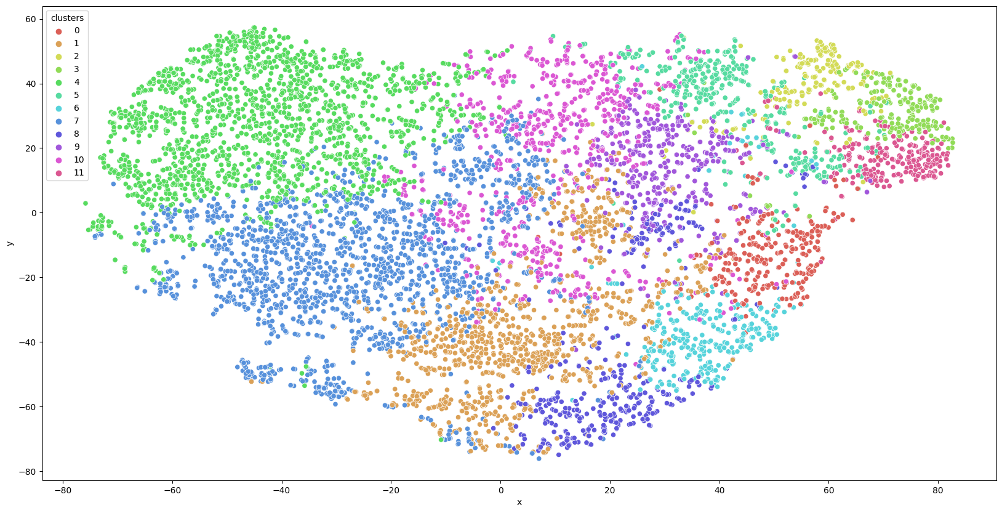
Color palette clustering: plain K Means - K = 12

Slide 44
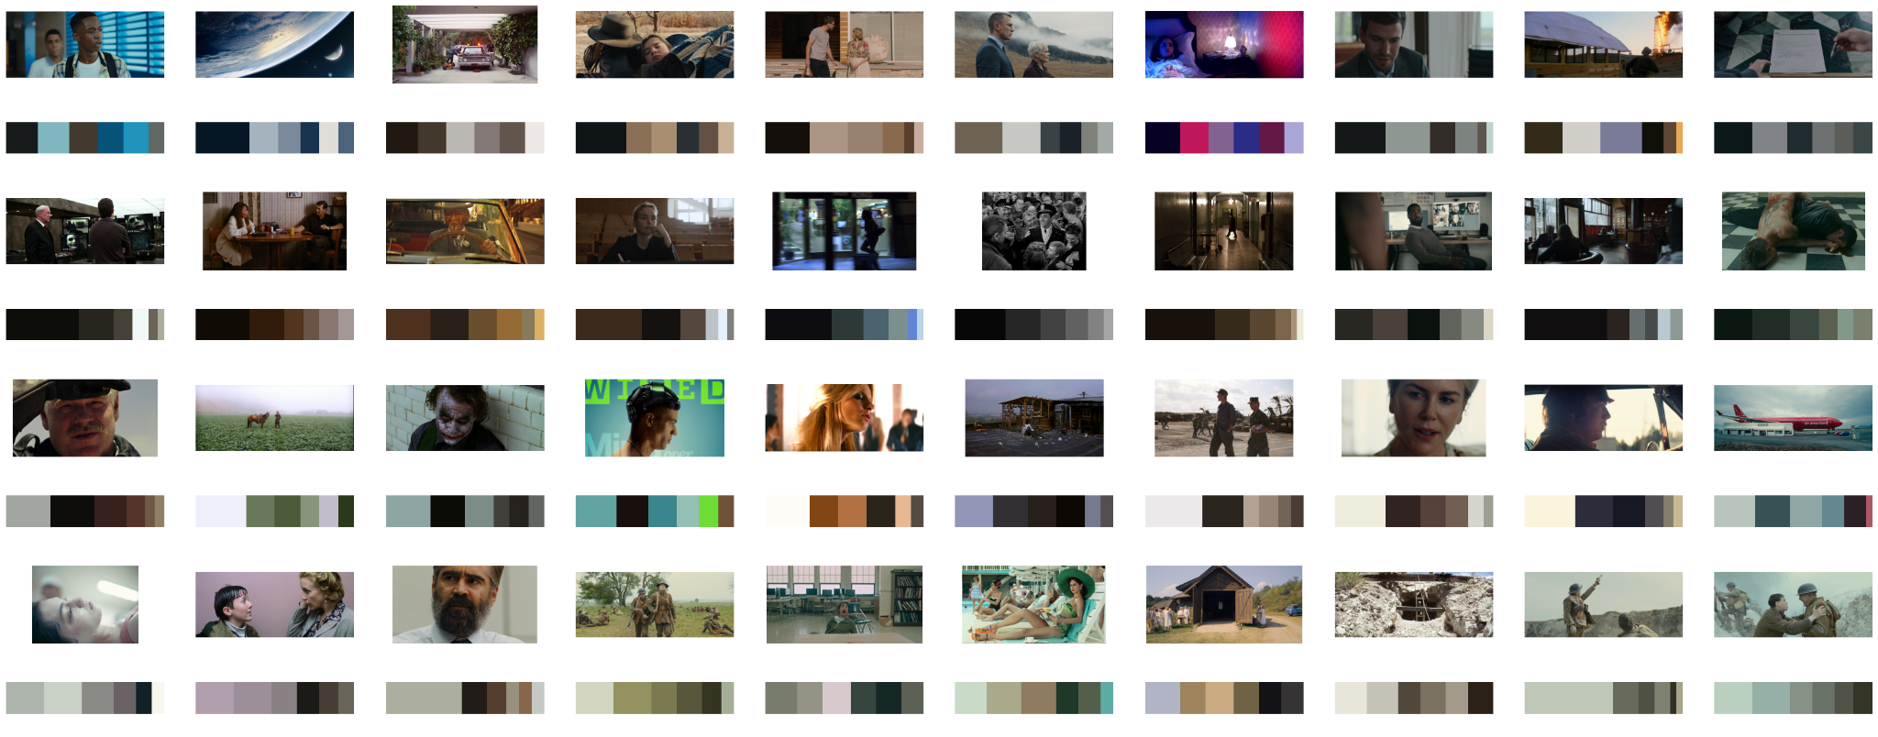
Color palette clustering: plain clusters (1st page)
K = 12

Slide 45
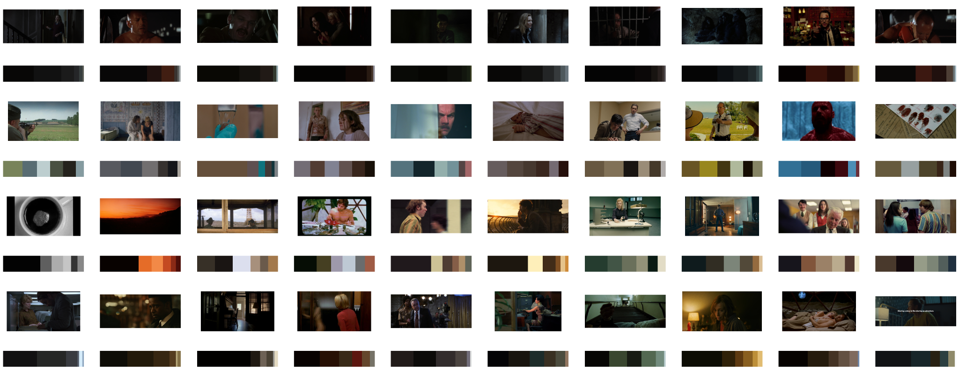
Color palette clustering: plain clusters (2nd page)
K = 12

Slide 46
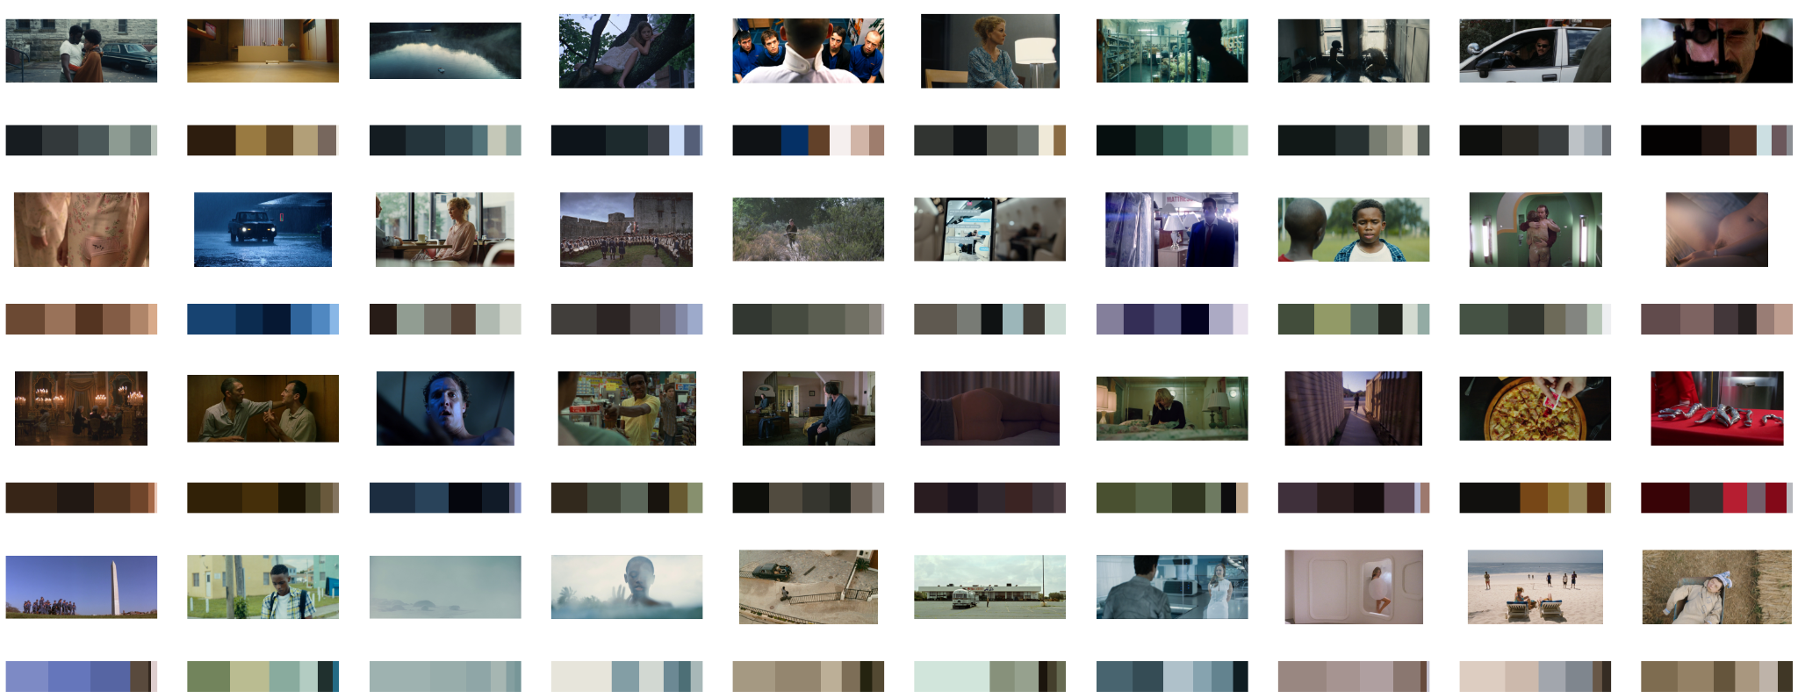
Color palette clustering: plain clusters (3rd page)
K = 12

Slide 47
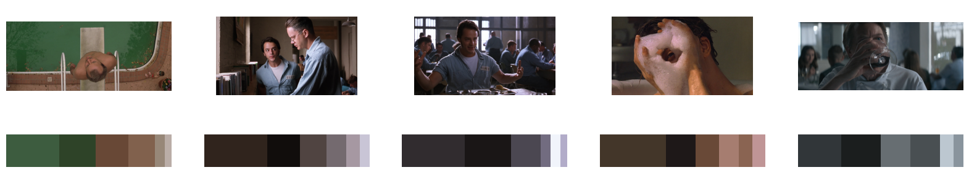
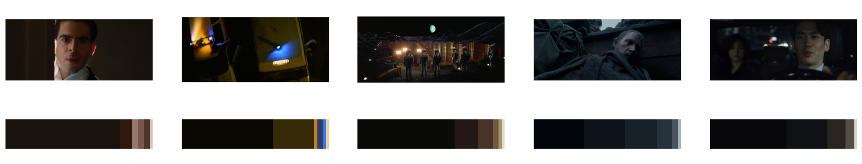
Color palette clustering: plain conclusions (K = 12)
green ???
yellow and blue ???

Slide 48
Color palette clustering: ResNet50 approach
Features Vector, 8192 columns
[0.12, 0.3467, . . ., 0.985]
ResNet50
[0.0024, 0.534, . . ., 0.12]
[0.0075, 0.123, . . ., 0.75]

Slide 49
Color palette clustering: ResNet50 approach
Features Vector, 8192 columns
[0.12, 0.3467, . . ., 0.985]
.
.
K-Means
[0.0024, 0.534, . . ., 0.12]
.
.
[0.0075, 0.123, . . ., 0.75]

Slide 50
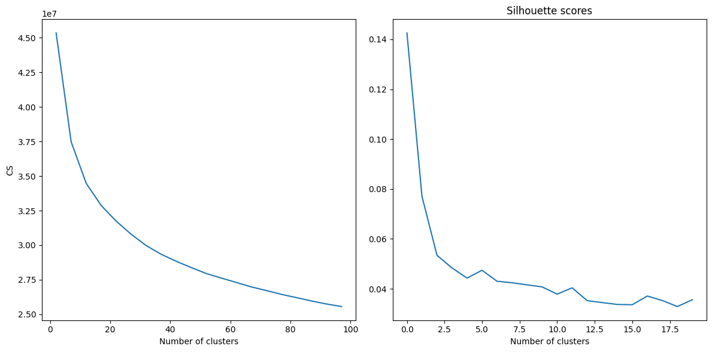
Color palette clustering: ResNet50 - Search of optimal K
*The values on the x axis of the silhouette score should actually be (x*5)+2, so 5 it’s actually 27 and the graph goes from to 100 just like the elbow method one

Slide 51
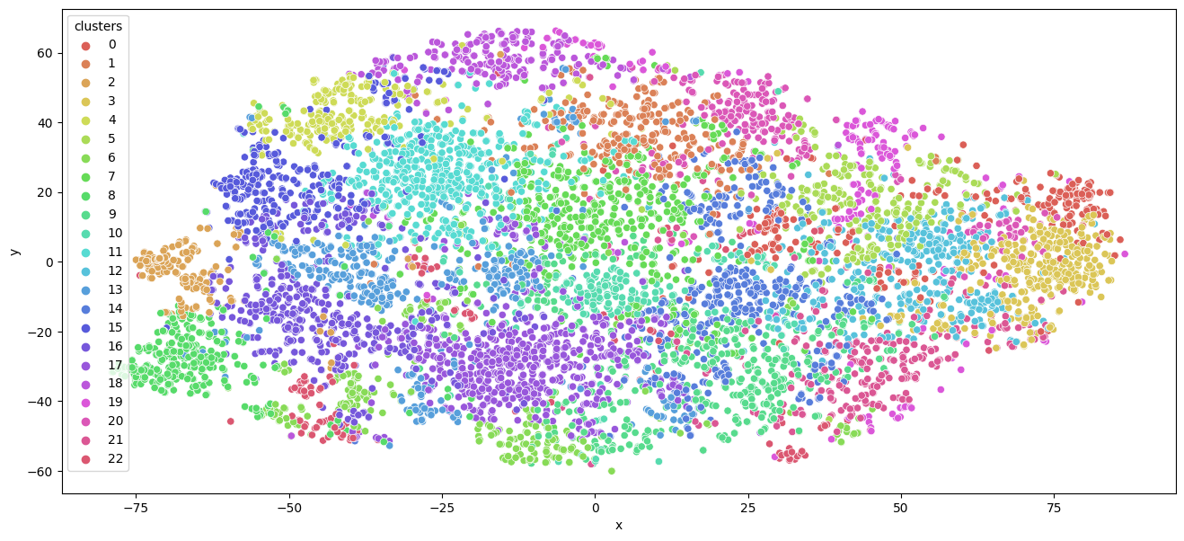
Color palette clustering: ResNet50 t-SNE with K = 23

Slide 52
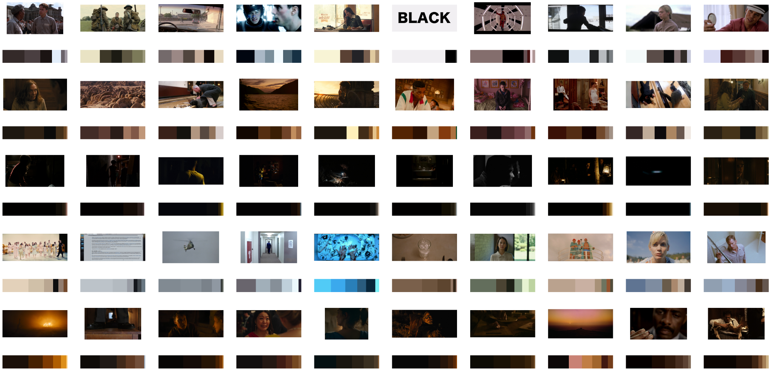
Color palette clustering: ResNet50 clusters (1st page)
K = 23

Slide 53
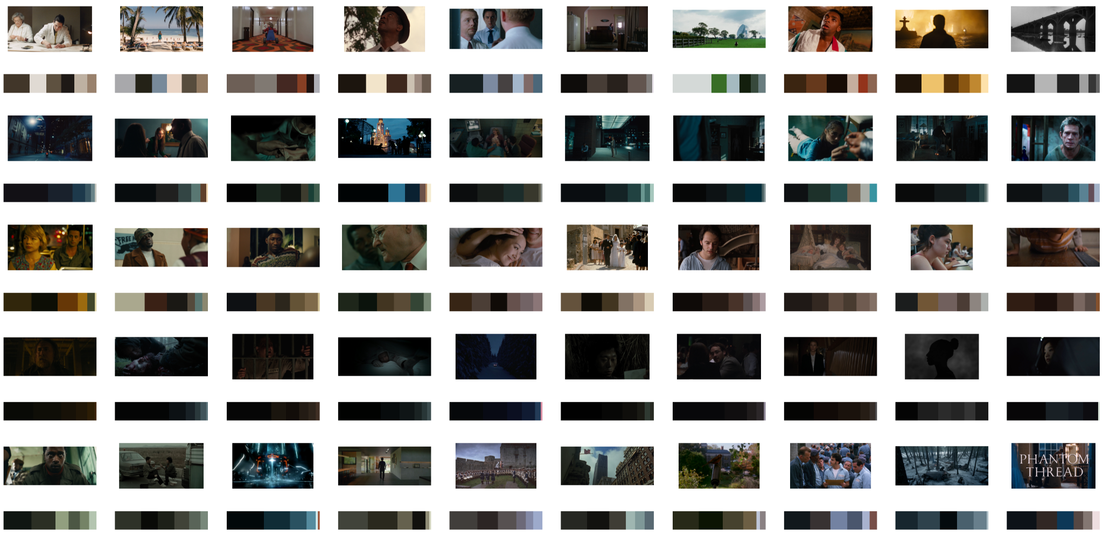
Color palette clustering: ResNet50 clusters (2nd page)
K = 23

Slide 54
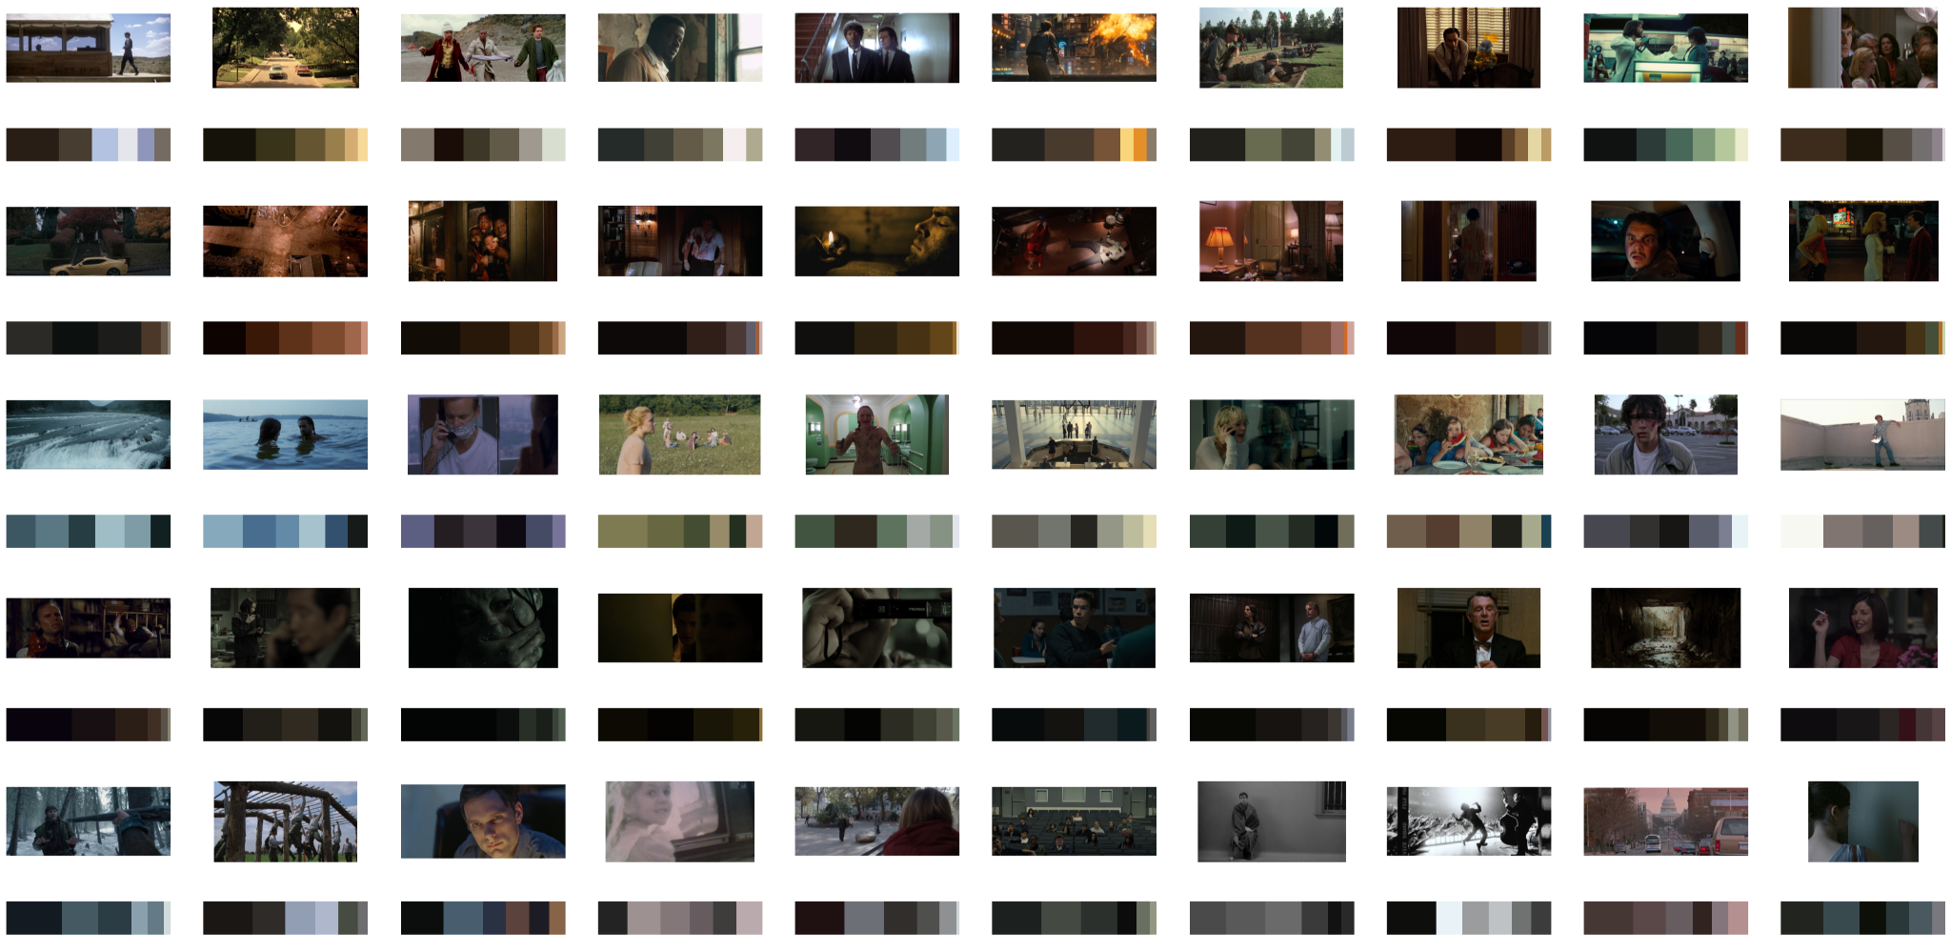
Color palette clustering: ResNet50 clusters (3rd page)
K = 23

Slide 55

Color palette clustering: ResNet50 clusters (4th page)
K = 23

Slide 56

Color palette clustering: ResNet50 clusters (5th page)
K = 23

Slide 57
Color palette clustering: ResNet50 with K = 70
Higher K creates better clusters?
We tried K = 70 to see what was going to happen

Slide 58

Color palette clustering: ResNet50 conclusions (K = 23)
Desaturated
Vivid
High Contrast

Slide 59



Color palette clustering: ResNet50 conclusions (K = 70)
Prevalence of red
Blue and yellow
Shades of torquoise

Slide 60



Possible Applications
semi-automate tagging of images for the developer of the shot.cafe website
helping video editors to create edit in a faster way clustering images based on their color palette or on their tags
helping cinema students figure out which image is what, and create a self configuring camera system for videomakers.

Slide 61
Thanks for your attention!
Notes:
Thanks for your attention, if there are any question we will be happy to answer

